Slide 1
US Decision Science
DBU Targeting Assessment
September 2007

Slide 2
Contents
Key Takeaways
Scorecard Summary
Tier coverage anomalies
Outlier geographies - Coverage below/above planned levels
Potential targeting changes (MDs to add/remove)

Slide 3
Key Takeaways
Overall, implementation at a national level is close to plan in both MD and Rx coverage, which translates into a significant improvement in coverage compared to post-Oaktree levels.
In areas where there is some deviation by more than 4% from plan, the difference can be explained by greater-than-expected overlap of NQDB with Health and Care (8.4% Actual vs 0% plan).
A retargeting effort is not necessary at this time. Instead, efforts could be focused on improving coverage in specific geographies.

Slide 4
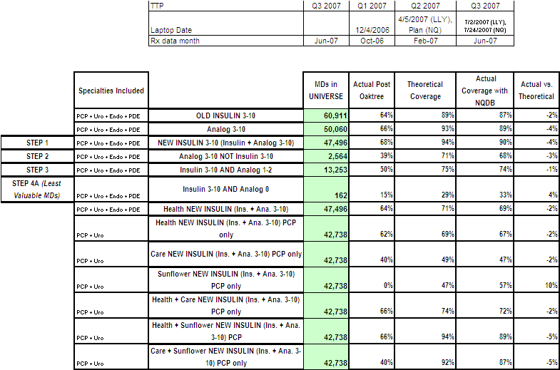
Scorecard Summary – MDs (1)
Step 1 MD coverage: Sunflower is covering 10% more, and Health + Sunflower and Care + Sunflower are each covering 5% less than planned
This is due to greater overlap between Health, Care, and NQDB than planned

Slide 5
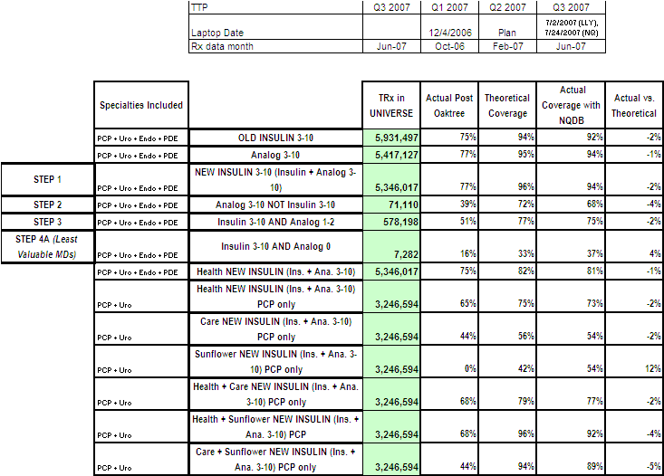
Scorecard Summary – TRx (1)
Step 1 MD coverage noted on the previous slide translates as expected for TRx coverage.

Slide 6
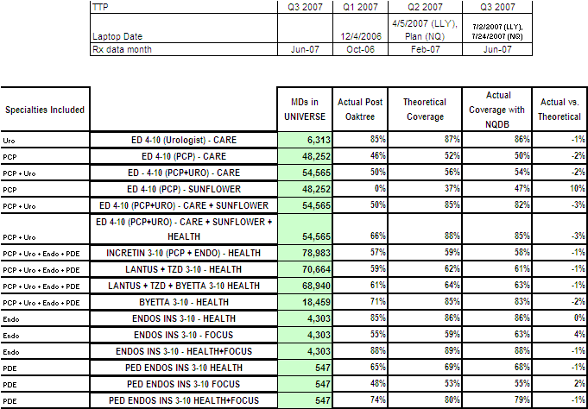
Scorecard Summary – MDs (2)
Sunflower is covering more ED 4-10s than planned (47% vs. 37%)

Slide 7
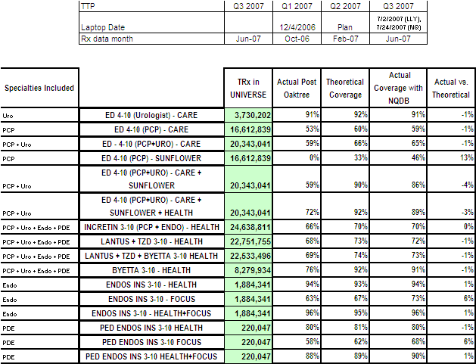
Scorecard Summary – TRx (2)
Sunflower is covering more ED Tablets than planned
Focus is covering more Endo/Ped Endo TRx than planned

Slide 8
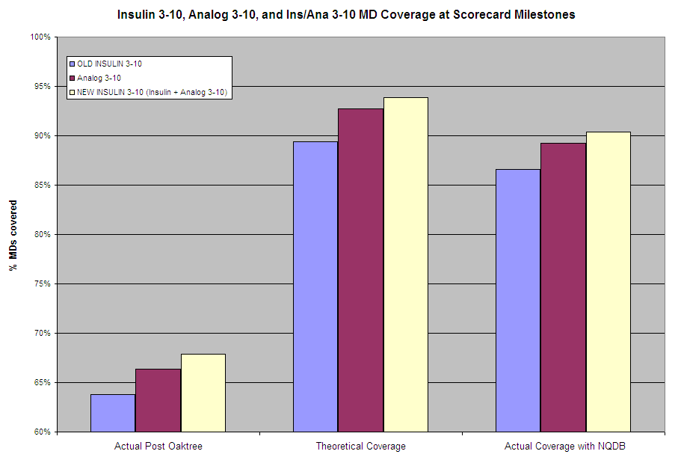
MD Coverage at Scorecard Milestones
Addition of NQDB increased coverage of Insulin/Analog 3-10s by 20%+...

Slide 9
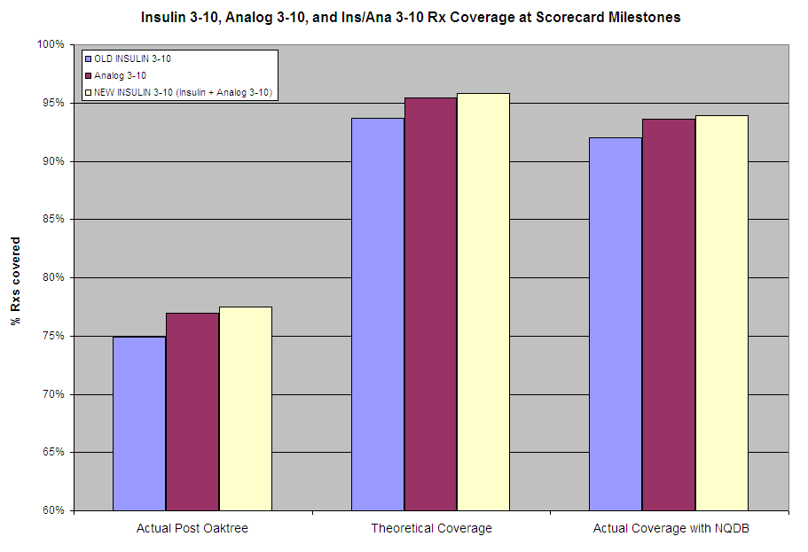
TRx Coverage at Scorecard Milestones
...and Insulin/Analog TRx by 15%+

Slide 10
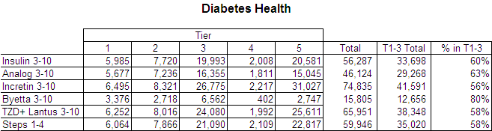
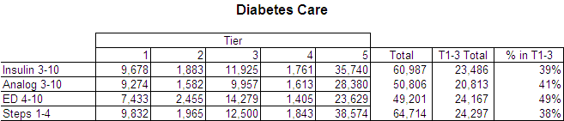
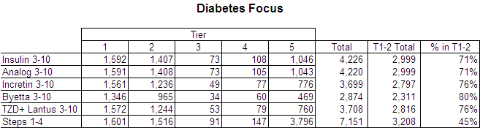
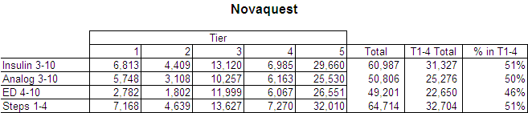
Coverage by Sleeve and Tier
Byetta coverage in Health and ED coverage in Care appears to be low.
The ED difference appears to be made-up by NQDB.
Based on tiering as of July 2 and June TRx data

Slide 11
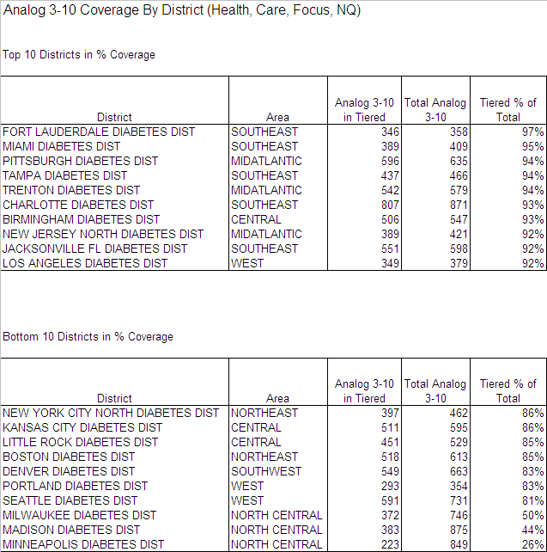
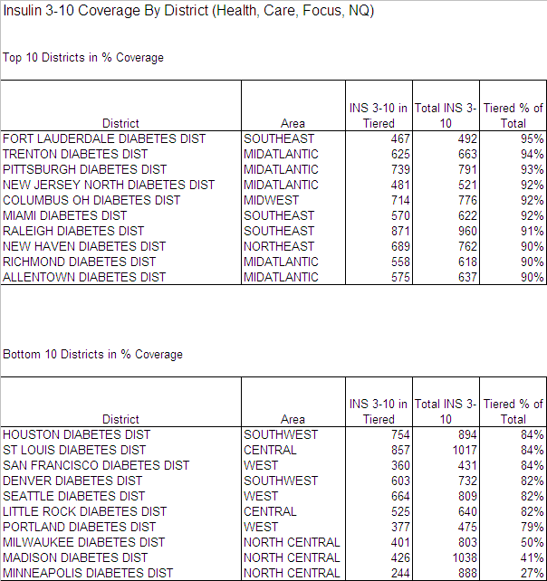
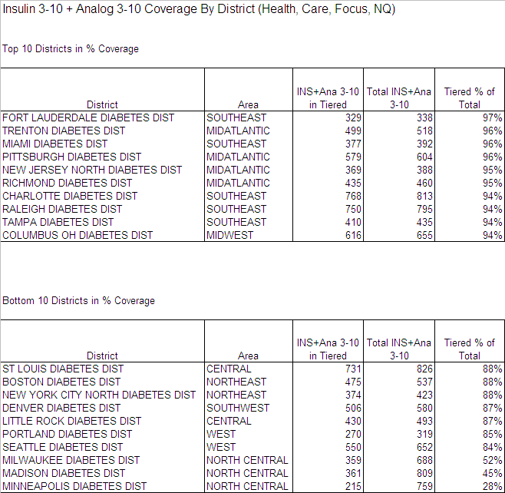
District Level Coverage - Insulins
Almost all districts have Insulin+Analog 3-10 coverage above 80%
Based on tiering as of July 2 and June TRx data. Tiered MDs are those who are T1-3 for Health and Care, T1-2 for Focus, and T1-4 for NQDB

Slide 12
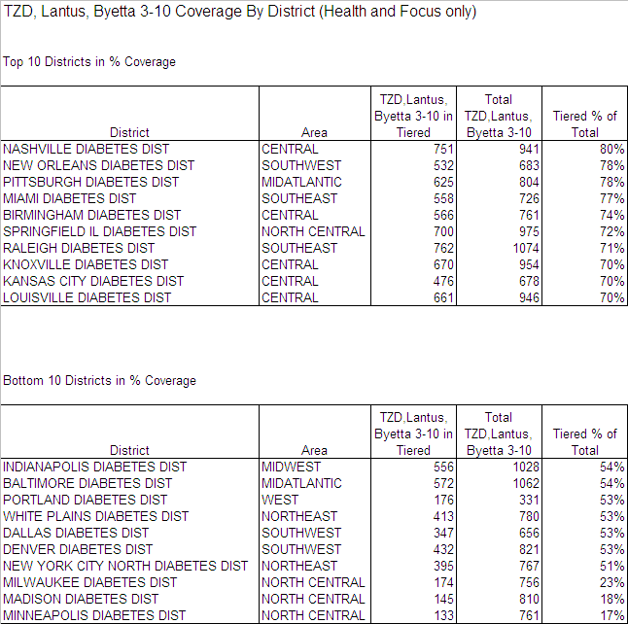
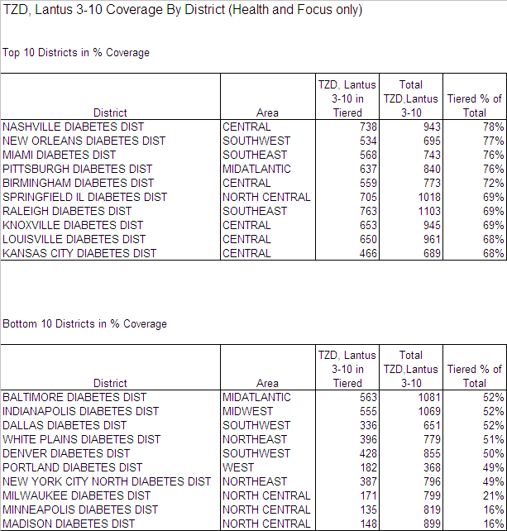
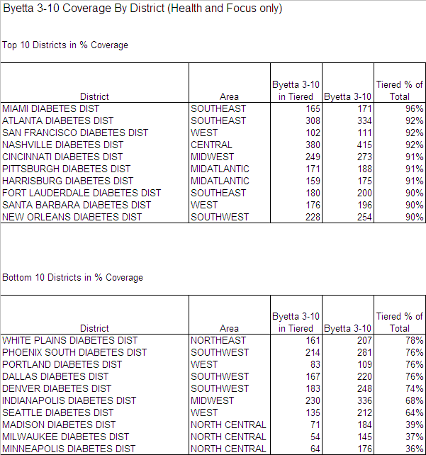
District Level Coverage – TZD, Lantus, Byetta
Lantus and Byetta Coverage is lower than expected in a significant number of distrcts (goal is 59% incretin, 62% TZD + Lantus, 64% TZD + Lantus + Byetta)
Based on tiering as of July 2 and June TRx data. Tiered MDs are those who are T1-3 for Health and T1-2 for Focus

Slide 13
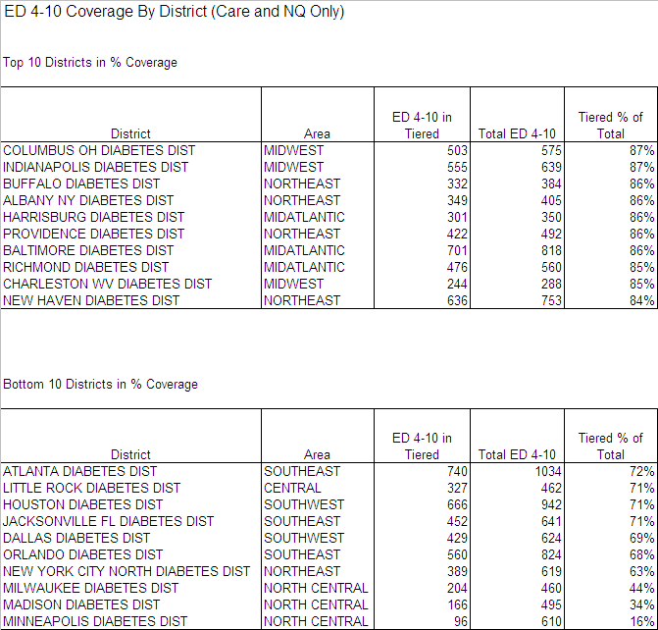
District Level Coverage - ED
Coverage of ED is above 70% in most districts
Based on tiering as of July 2 and June TRx data. Tiered MDs are those who are T1-3 for Care and T1-4 for NQDB

Slide 14
Potential Targeting Changes
To simplify this process, instead of re-running the targeting algorithm (as we did in the previous version of this targeting assessment), we simply calculated the number of non-tiered high-value customers who could be swapped for tiered low value customers
We assumed that there would be no net addition of targets per rep, so at most we would add only as many targets as we dropped
The definitions of high value for each sleeve were
  Health: Step 1-4 or Incretin 3-10
  Care: Step 1-4 or ED 4-10
  Focus: Step 1-4 or Incretin 3-10
  Novaquest: Step 1-4 or ED 4-10
Low value MDs are those who do not meet these criteria, but who are tiered

Slide 15
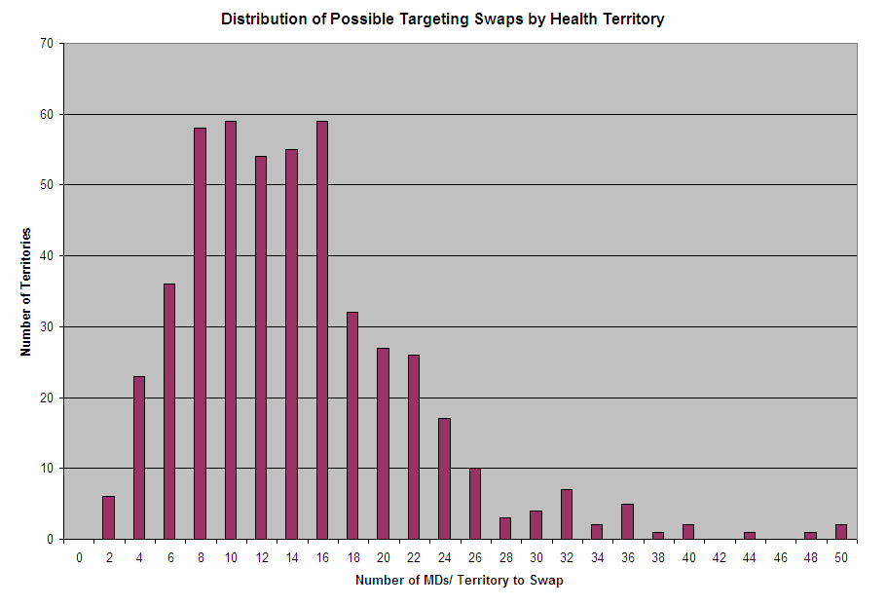
Potential Targeting Changes - Health
About 6,800 low-value MDs (14 MDs per territory) could be swapped for high-value MDs
367 territories could swap 10 or more MDs, depending on local territory knowledge
Based on tiering as of July 2 and June TRx data

Slide 16
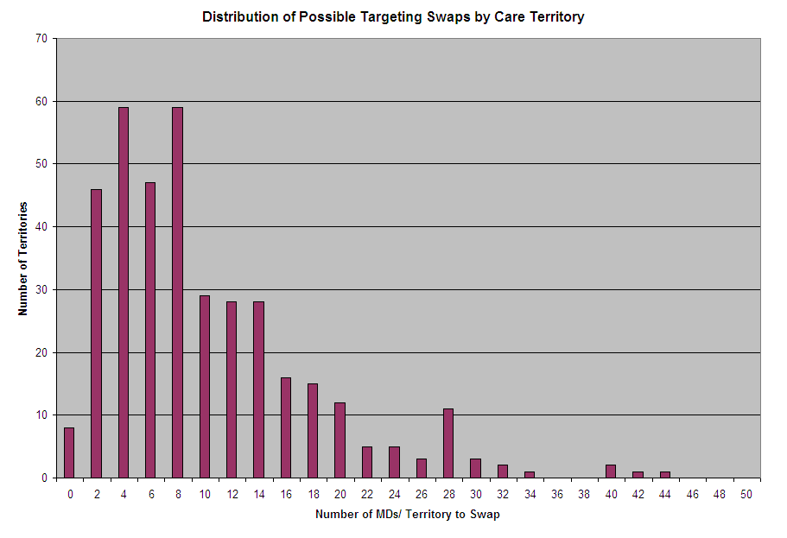
Potential Targeting Changes - Care
A total of 3,600 low-value MDs (10 MDs per territory) could be swapped for Step 1-4 MDs, or MDs who are ED 4-10
162 territories could swap 10 or more MDs, depending on local territory knowledge
Based on tiering as of July 2 and June TRx data

Slide 17
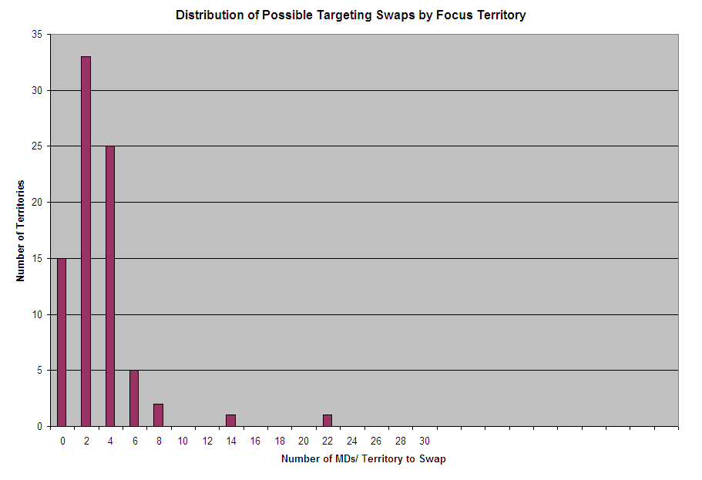
Potential Targeting Changes - Focus
There is an opportunity to swap about 200 low-value MDs for Step 1-4 MDs, or MDs who are Incretin 3-10
Only 8 territories would require more than 4 targets to change
Based on tiering as of July 2 and June TRx data

Slide 18
Backup

Slide 19
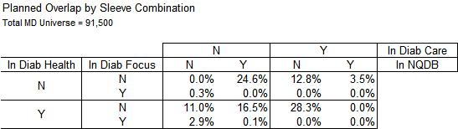
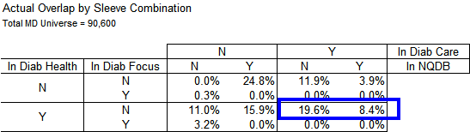
Sleeve Overlap – Planned vs. Actual
Actual overlap of Health and Care is close to plan (28% actual vs. 28.3% plan)
Overlap of NQDB with both Health and Care, however, is much larger than plan (8.4% actual vs. 0% plan). This results in reduced overall coverage of Analog /Insulin 3-10s, as well as of the ED 4-10s
The recommended number of unique targets for Diabetes Care was 91,500*28.3% = 25,894 MDs vs. actual unique targets of 90,600* 19.6%= 17,758 MDs
Unique targets for Diabetes Care

Slide 20
Deciling Error in the Earlier Targeting Assessment
Analog Deciles were created in October 2006, December 2006, March 2007, April 2007, and May 2007
The Analog decile table created in April and May 2007 were incorrect, due to the market basket in these instances having incorrectly excluded Lantus
As a result, a smaller number of doctors were identified as being Analog deciles 1-10
Because of the timing, this did not affect the accuracy of the target lists
There are in fact about 50K Analog 3-10s!

Slide 21
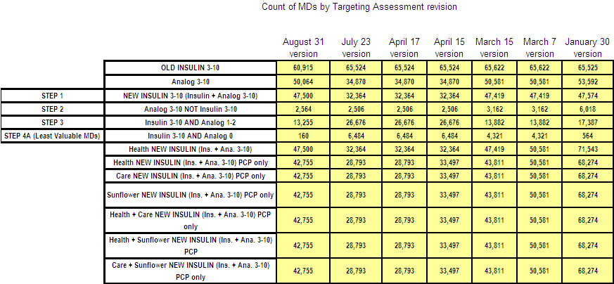
Counts of MDs by Targeting Assessment revision
The error occurred beginning with the April 15 targeting assessment
The error has been corrected

